Slide 1

SMART MART
Abinaya Vaidhyanathan
Kishan Singh
Yunfei Liao
Ashay Shah
Pavani Velichati

Slide 2
INTRODUCTION
BUSINESS PROBLEM
Online electric business marts are there to buy/sell different brands.
The inventory keepers raise.
The customers will never get a chance to know the actual price of the product.
GOAL
Our goal is to sell the product directly by the vendor and consume it by the people. This helps to buy the product to its original price.

Slide 3
DEVELOPMENT FLOWCHART
COLLECTING REQUIREMENTS
DESIGN
DVELOPMENT
TESTTING
MODIFY

Slide 4
DEVELOPMENT PLAN
TECHNOLOGIES USED
Front-End Technology: AngularJS.
Back-End Technology: NodeJS (Express JS)
Cloud Database: MongoDB Atlas
Facebook SDK - Facebook Login
Amazon SNS for the email notification.
COLLECTING REQUIREMENTS
DESIGN
DVELOPMENT
TESTTING
MODIFY

Slide 5
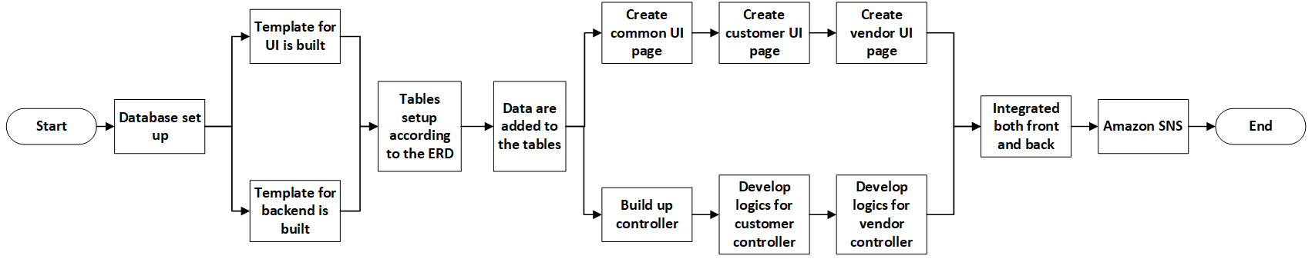
DEVELOPMENT FLOWCHART

Slide 6
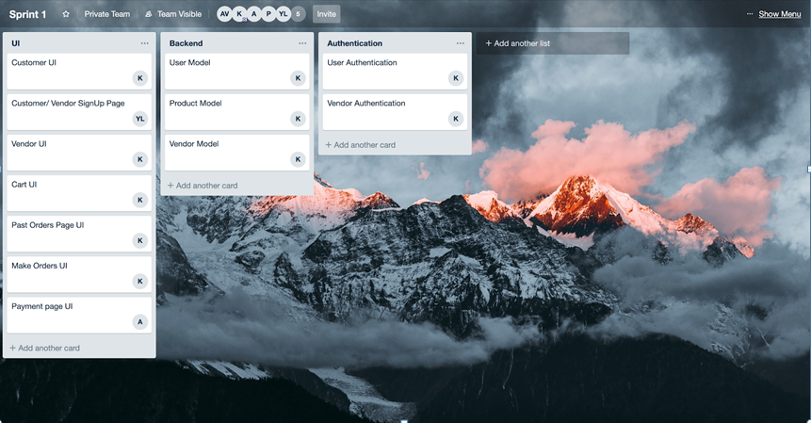
DEVELOPMENT PLAN – SPRINT 1

Slide 7
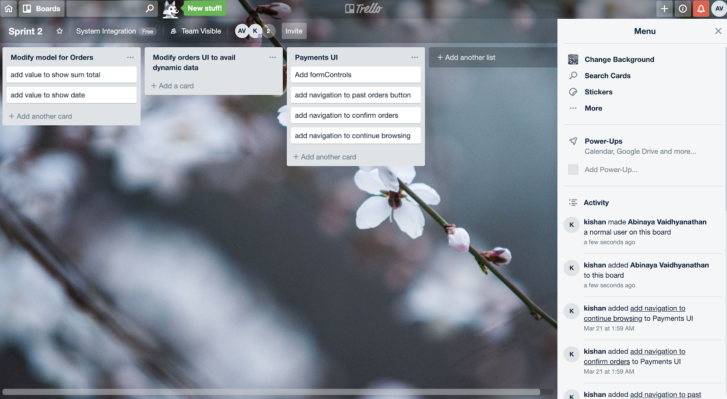
DEVELOPMENT PLAN – SPRINT 2

Slide 8
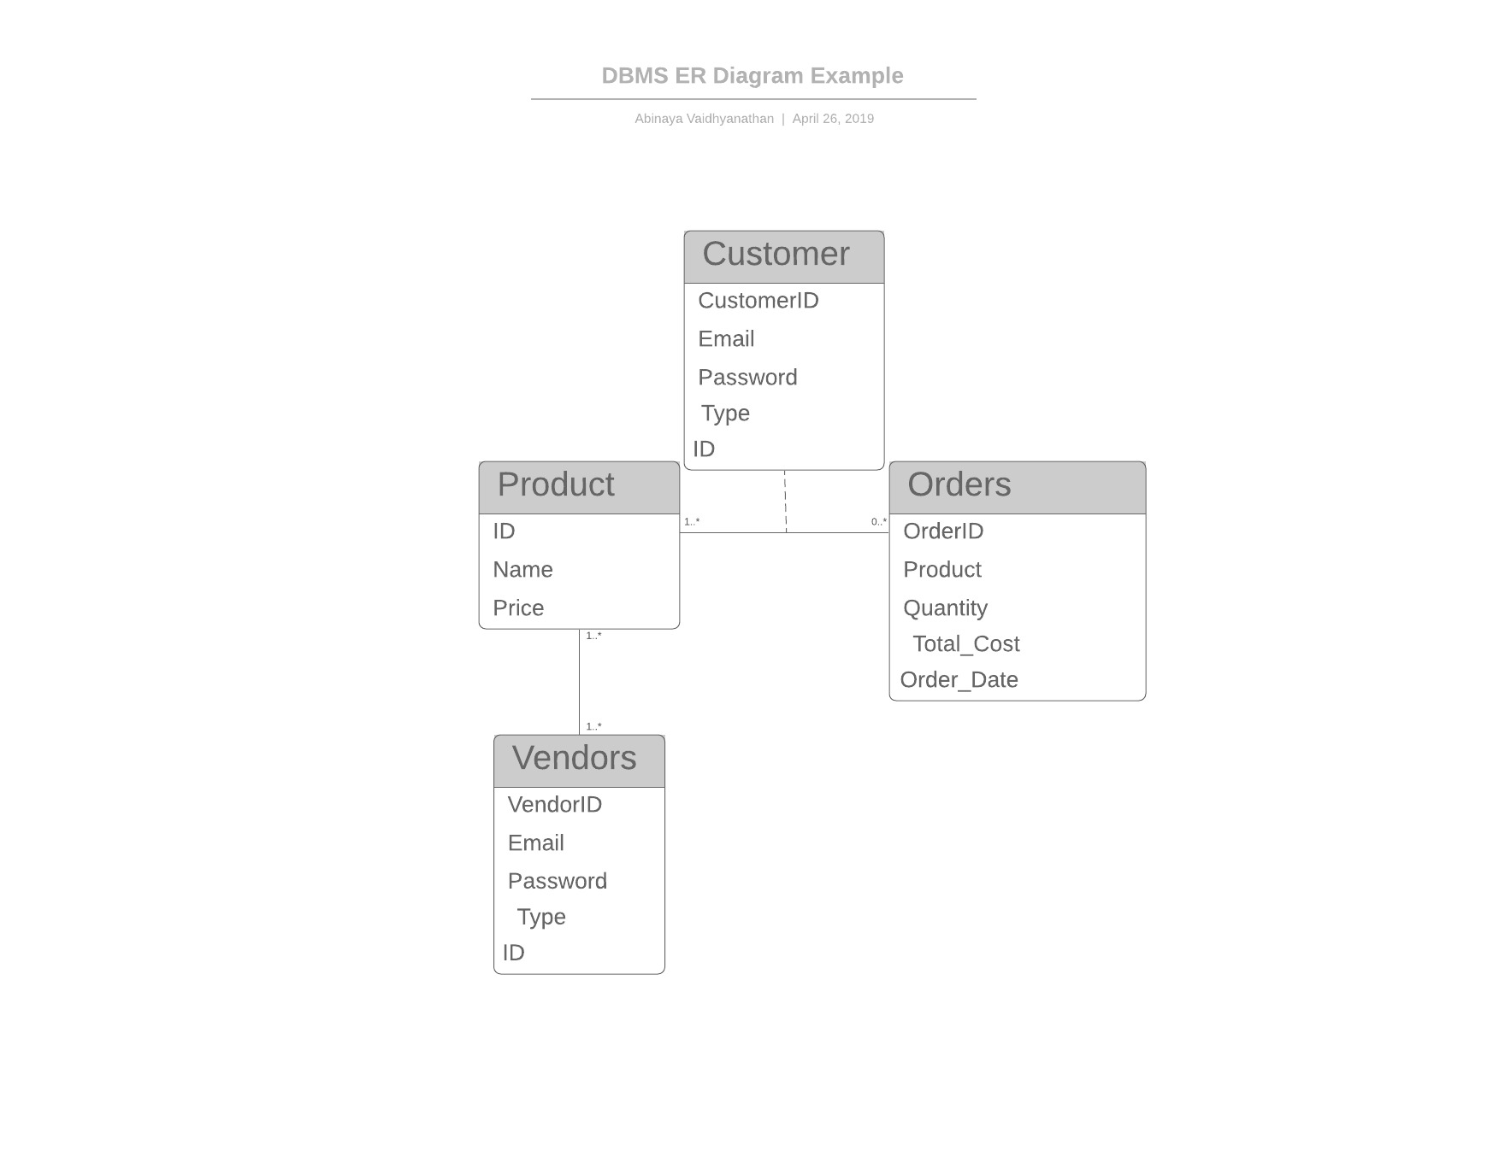
DATA DIAGRAM – ER DIAGRAM

Slide 9
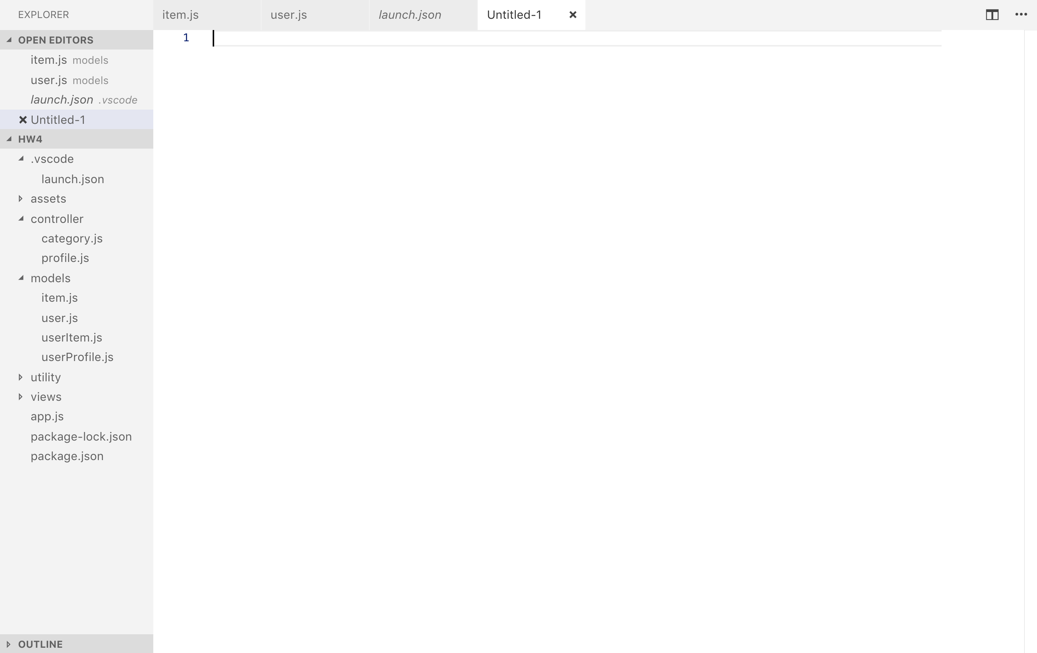
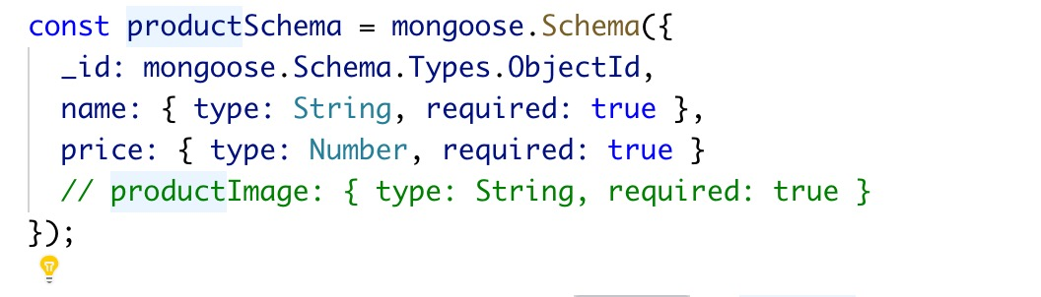
DATA DIAGRAM -- DATA
PRODUCT

Slide 10
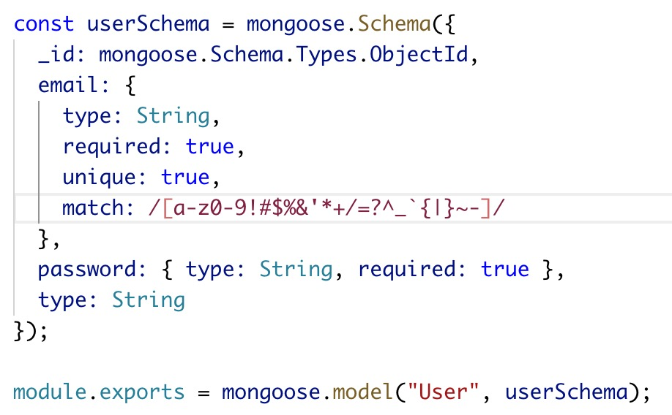
DATA DIAGRAM -- DATA
CUSTOMER

Slide 11
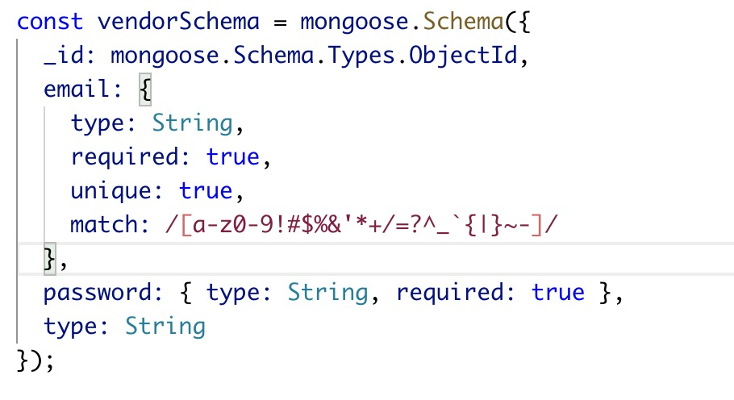
DATA DIAGRAM -- DATA
VENDOR

Slide 12
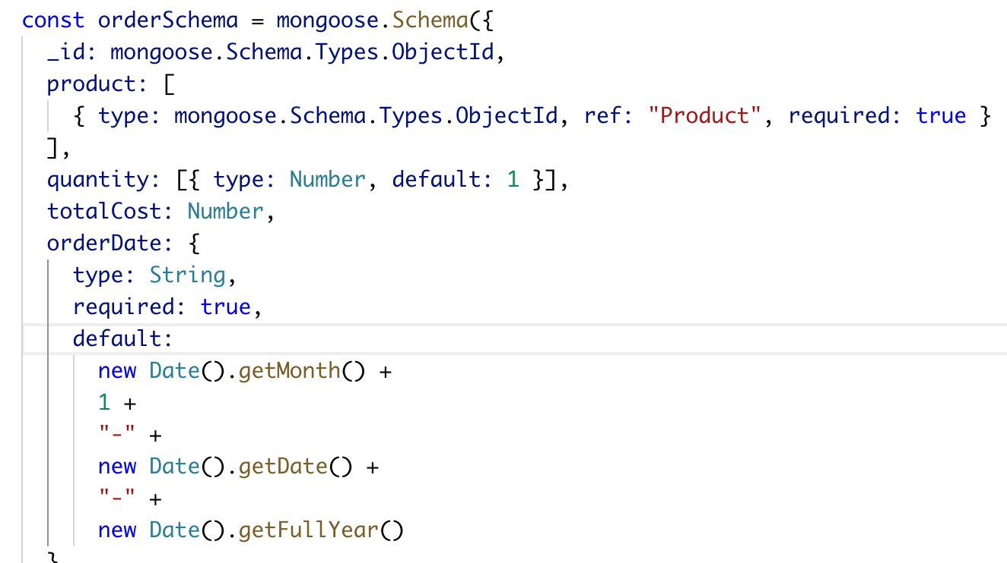
DATA DIAGRAM -- DATA
ORDER

Slide 13
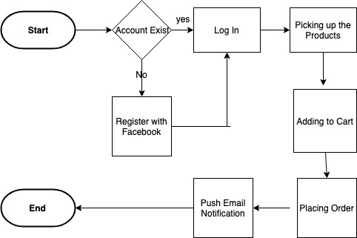
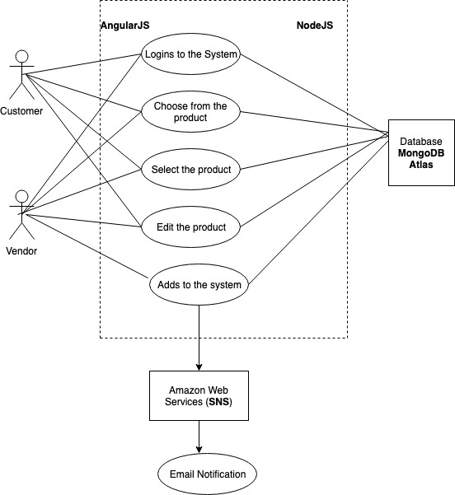
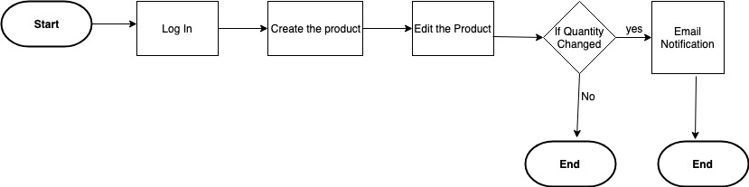
SYSTEM DIAGRAM
SYSTEM DIAGRAM
LOGICAL DIAGRAM
LOGICAL DIAGRAM

Slide 14
CLOUD HIGHLIGHTS
MongoDB Atlas clustered deployed on Cloud
Amazon SNS is used for Email notification.

Slide 15
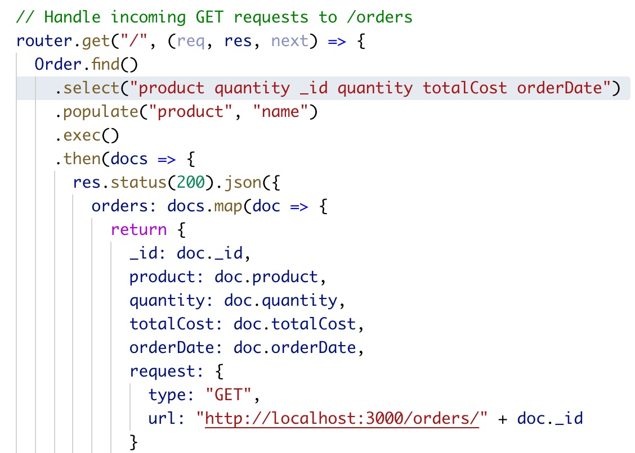
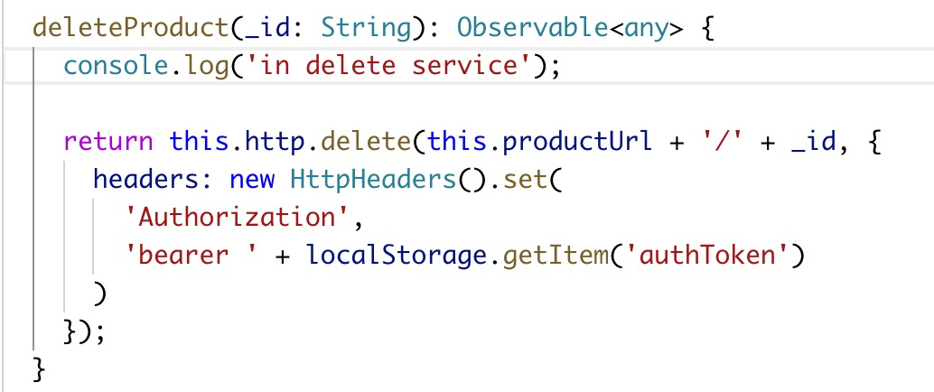
AUTHORIZED ACCESS OPERATIONS
Pre-existence Validations
Requirement Specific Querying
Organized service calls
Header Validations
Bearer Tokens
Hashing & Salting

Slide 16
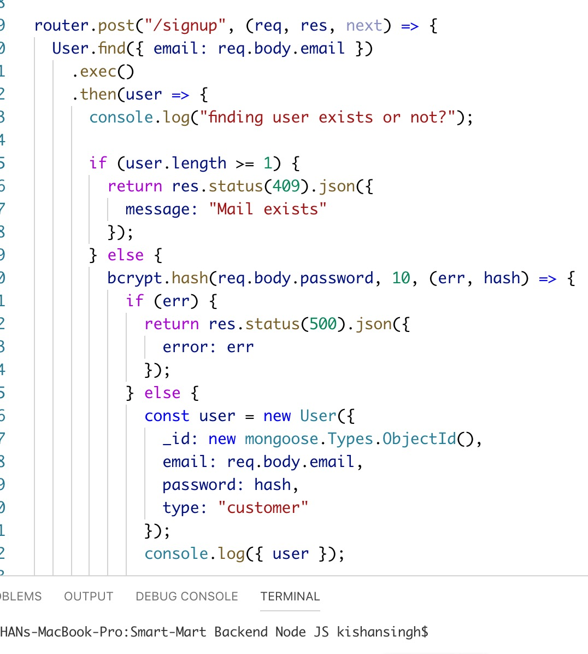
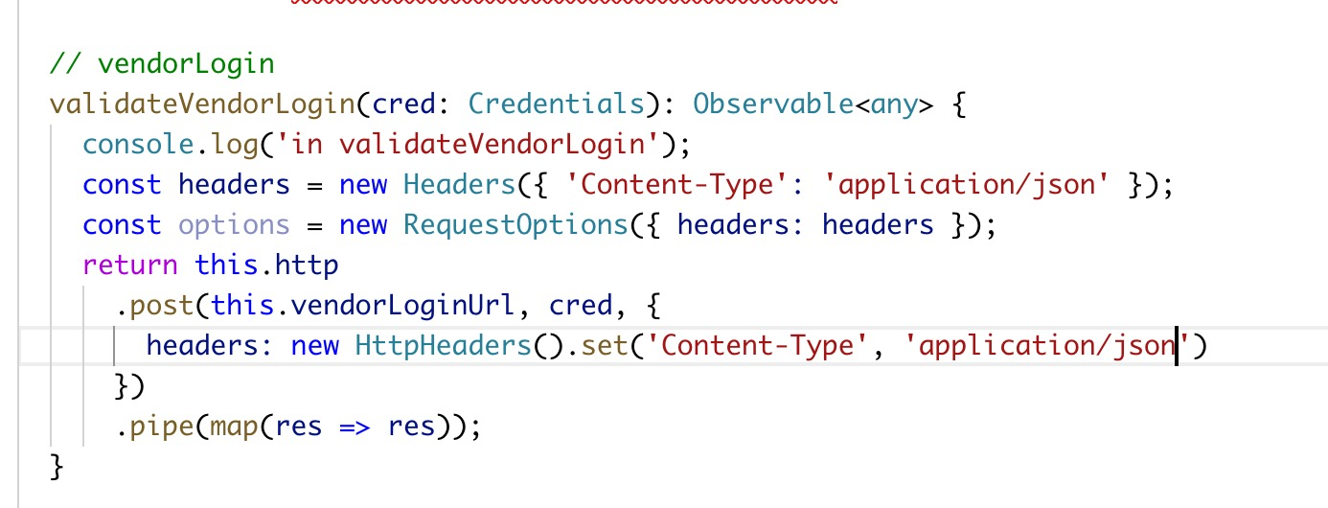
SIGNUP & LOGIN IMPLEMENTATION

Slide 17
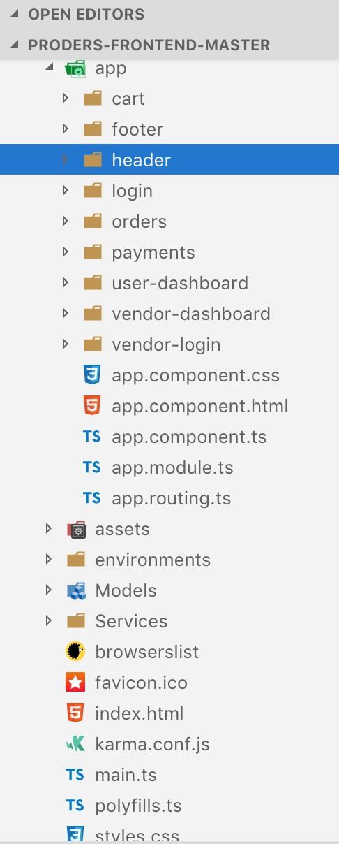
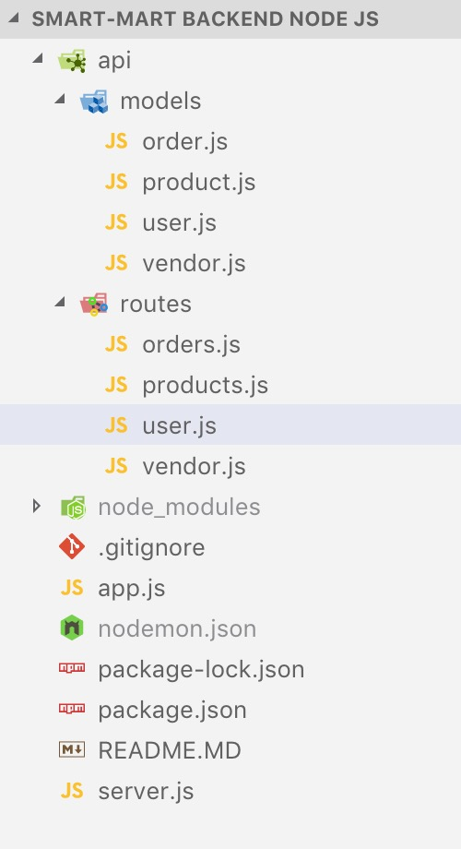
APPLICATION HIGHLIGHTS
Modular Development
Incremental Approach
Development Layering
Users → User login → pick items → pay → see orders
Vendors → vendor login → add new products

Slide 18
APPLICATION HIGHLIGHTS
Ecommerce website which integrates the process right from log-in to system till the product reaches the customer.
Vendor can advertise their new products and modify the stock.
Customer can just visit the webpage and store the product of their wish.
This website also sends alert notification to vendor, when their product is out of stock.

Slide 19
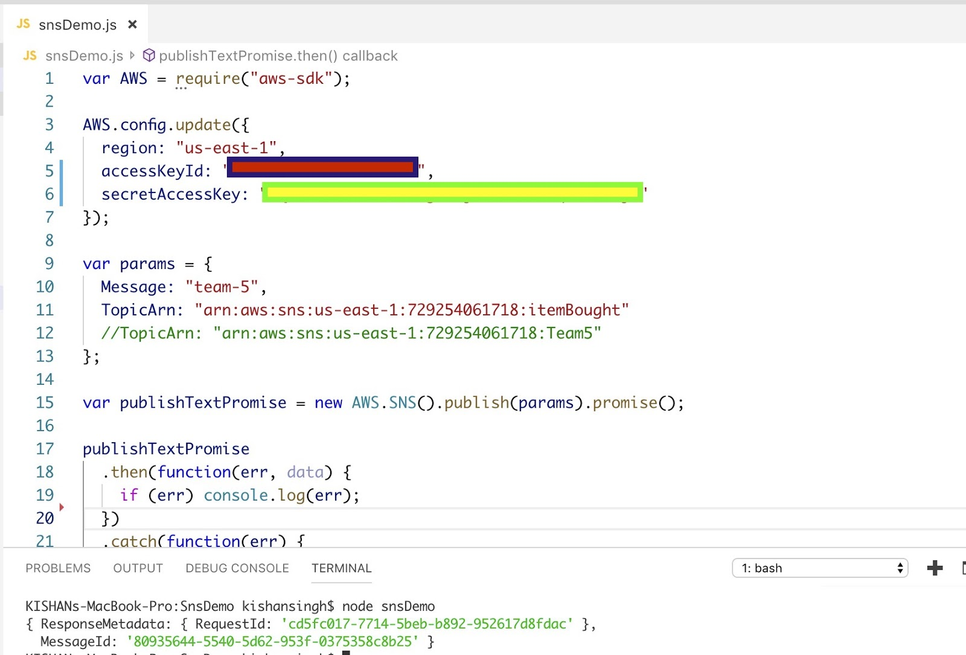
TEST RESULTS
SNS – Standalone Test

Slide 20
CHALLENGES
Cloud Integrations
Customized SNS Email notifications
Triggering SNS linked to backend from the frontend.
Integrating facebook login via SDK and TypeScript LifeCycle transformations to adapt to the event.
Handling ngZone() issues
Storing authentication tokens and headers with prescribed timeOuts.
Maintainable model structure to adapt to future changes.

Slide 21
FUTURE WORK
We plan to add some visual analytical function for the vendor to check the sales volume, such as a kanban with a pie chart to present the data.
We will try to track the packages and send the notification to the customer at the each end.
We will also try to host our NodeApp in EC2 and AngularApp in Elastic BeanStalk.

Slide 22
CONCLUSION
This project made us know more on the technology since, each one of us expertise in different things.
Helps learn more on the cloud services and different options on Amazon web services.
Helps us to learn on the people issues.

Slide 23
QUESTIONS ?

